Slide 1
AZ-900T0x Learning Path: Examine Microsoft Azure Security, privacy, compliance, and trust
Notes:
Adjust the cover for either AZ-900T00 or AZ-900T01.

Slide 2
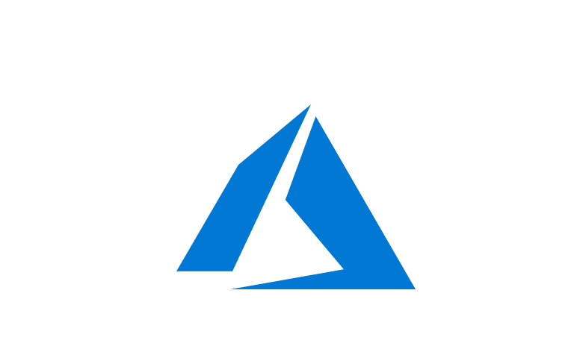
Learning Objectives
You will learn the following concepts:
Networking
Defense in depth
Firewalls, DDoS, Network Security Groups, and more
Azure Identity
Authentication, Authorization, and MFA
Security Tools
Azure Security Center
Information Protection and Advanced Threat Protection
Azure Governance, Compliance, and Monitoring
Policy and Blueprints
Trust Center, Compliance Manager, and Government
Notes:
This slide is important. We are telling the learners… This is what I am going to tell you.
We then tell them / show them.
At the end we review what we told them.
Then we give them references for further learning.
Then we say Thanks you where we will then put our closing deck for customer feedback…

Slide 3
Module: Securing network connectivity

Slide 4
Securing Network Connectivity Introduction
Learning objectives:
Learn how security responsibility is shared with Azure
Learn how identity management provides protection, even outside your network
Learn how encryption capabilities built into Azure can protect your data

Slide 5
Explore Defense in depth
Physical Security
A layered approach to securing computer systems.
Provides multiple levels of protection.
Attacks against one layer are isolated from subsequent layers.
Identity & Access
Perimeter
Network
Compute
Application
Data
Notes:
This is conceptual, to be kept high level, explaining how security options can be targeted at each layer.

Slide 6
Define Shared security
Responsibility | On-Premises | IaaS | PaaS | SaaS
Data governance and Rights Management | Customer | Customer | Customer | Customer
Client endpoints | Customer | Customer | Customer | Customer
Account and access management | Customer | Customer | Customer | Customer
Identity and directory infrastructure | Customer | Customer | Microsoft/ Customer | Microsoft/ Customer
Application | Customer | Customer | Microsoft/ Customer | Microsoft
Network controls | Customer | Customer | Microsoft/ Customer | Microsoft
Operating system | Customer | Customer | Microsoft | Microsoft
Physical hosts | Customer | Microsoft | Microsoft | Microsoft
Physical network | Customer | Microsoft | Microsoft | Microsoft
Physical datacenter | Customer | Microsoft | Microsoft | Microsoft
Migrating from customer-controlled to cloud-based datacenters shifts the responsibility for security.
Security becomes a shared concern between cloud providers and customers.
Notes:
This is comparable to the Shared Responsibility slide, but specific to security.

Slide 7
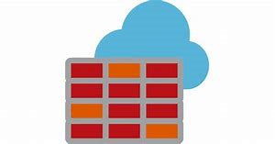
Explore Azure Firewall
Stateful, managed, Firewall as a Service (FaaS) that grants / denies server access based on originating IP address, to protect network resources.
✔️ Azure Application Gateway also provides a firewall, Web Application Firewall (WAF). WAF provides centralized, inbound protection for your web applications.
Notes:
✔️ Azure Application Gateway also provides a firewall, called the Web Application Firewall (WAF). WAF provides centralized, inbound protection for your web applications against common exploits and vulnerabilities.
Applies inbound and outbound traffic filtering rules.
Built-in high availability.
Unrestricted cloud scalability.
Uses Azure Monitor logging.
Azure Firewall - https://azure.microsoft.com/en-us/services/azure-firewall/

Slide 8

Explore Azure Distributed Denial of Service (DDoS) protection
What is a DDoS attack?
What does DDoS Protection do?
Sanitizes unwanted network traffic, before it impacts service availability.
Basic service tier is automatically enabled in Azure.
Standard service tier adds mitigation capabilities, tuned to protect Azure Virtual Network resources.
Notes:
Azure DDoS Protection - https://azure.microsoft.com/en-us/services/ddos-protection/
DDoS attacks overwhelm and exhaust network resources, making apps slow or unresponsive.
Sanitizes unwanted network traffic, before it impacts service availability.
Basic service tier is automatically enabled in Azure.
Standard service tier adds mitigation capabilities, tuned to protect Azure Virtual Network resources.

Slide 9

Define Network Security Groups (NSGs)
Filters network traffic to, and from, Azure resources on Azure Virtual Networks.
Set inbound and outbound rules to filter by source and destination IP address, port, and protocol.
Override default rules with new, higher priority, rules.
Notes:
NSG -https://docs.microsoft.com/en-us/azure/virtual-network/security-overview#network-security-groups

Slide 10

Define Application Security Groups (ASGs)
ASGs - provide for the grouping of servers with similar port filtering requirements, and group together servers with similar functions, such as web servers.
Notes:
ASG - https://docs.microsoft.com/en-us/azure/virtual-network/security-overview#application-security-groups
Allows you to reuse your security policy at scale without manual maintenance of explicit IP addresses.
Handles the complexity of explicit IP addresses and multiple rule sets, allowing you to focus on your business logic.

Slide 11
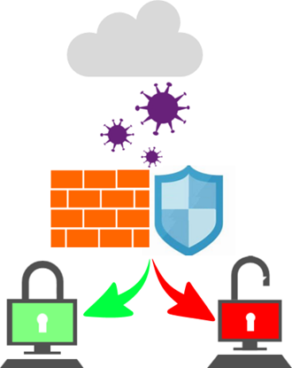
Choose Azure network security solutions
Azure supports combined network security solutions:
NSGs with Azure Firewall
Web Application Firewall (WAF) with Azure Firewall.
Perimeter layer protects your networks’ boundaries with Azure DDoS Protection and Azure Firewall.
Networking layer only permits traffic to pass between networked resources with Network Security Group (NSG) inbound and outbound rules.
Notes:
This slide uses the Defense in Depth perimeter and networking layers as examples. Discussing Azure networking security solutions at each layer is beyond the scope of this course.

Slide 12
Walkthrough – Secure network traffic
Create and configure inbound and outbound security port rules.
Deploy a custom template to create a virtual machine.
Create a network security group.
Create an inbound security port rule to allow RDP.
Configure an outbound security port rule to deny Internet access.

Slide 13

Knowledge Check Populate with instructions to use the polling tool of your choice
Which one?
A). Azure Portal
B). PowerShell
C). Local Tool
Module: Securing Network Connectivity
Use your Smartphones or Mobile Devices
Go to (insert polling app link of your choice) Enter Code: 123-45-678
Please participate in the quiz for this section
Notes:
WWL recommends using polling to be completed for every 7 – 10 slides and preferably at the end of each section. This helps break classes up and adds more interactivity especially for remote classes.
In order to promote interactivity, WWL suggests the use of Mentimeter, Kahoot or a similar polling technology. Please feel free to adjust this slide as needed and populate with the instructions based on the polling tool of your choice.

Slide 14
Summary: Securing network connectivity
In this module we explored the tools and capabilities to apply network security to your solutions in the cloud. Using a concept of Defense in Depth, you add layers of security onto your systems make it more difficult for attackers to get access to your data.

Slide 15
Module: Core Azure identity services

Slide 16
Core Azure identity services Introduction
Learning objectives:
Review authentication versus authorization
Explain Azure Active Directory
Explore Azure Multi-factor authentication (MFA)

Slide 17








Compare Authentication and authorization
Two concepts are fundamental to understanding identity and access.
Authentication
Authorization
Notes:
✔️Authentication is sometimes shortened to AuthN, and authorization is sometimes shortened to AuthZ.
Authentication
Identifies the person or service seeking access to a resource.
Requests legitimate access credentials.
Basis for creating secure identity and access control principles.
Authorization
Determines an authenticated person’s or service’s level of access.
Defines which data they can access, and what they can do with it.

Slide 18

Explore Azure Active Directory (AD)
Microsoft Azure’s cloud-based identity and access management service.
Authentication (employees sign-in to access resources).
Single sign-on (SSO).
Application management.
Business to Business (B2B).
Business to Customer (B2C) identity services.
Device management.
Notes:
Azure AD - https://azure.microsoft.com/en-us/services/active-directory/

Slide 19
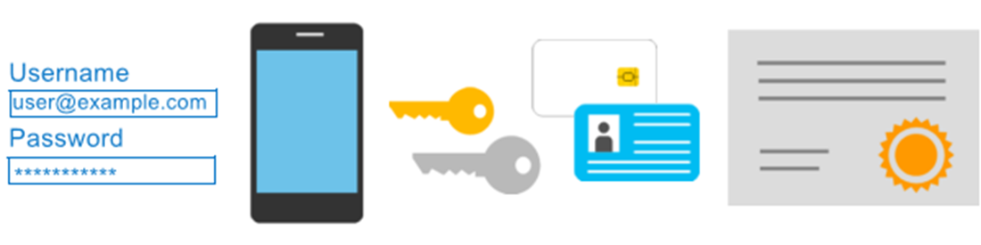
Explore Azure Multi-Factor Authentication
Provides additional security for your identities by requiring two or more elements for full authentication.
Notes:
Discuss what could qualify for each of the items listed
Something you know: This could be a password or the answer to a security question.
Something you possess: This might be a mobile app that receives a notification, or a token-generating device.
Something you are: This is typically some sort of biometric property, such as a fingerprint or face scan used on many mobile devices.
MFA - https://docs.microsoft.com/en-us/azure/active-directory/authentication/concept-mfa-howitworks

Slide 20

Knowledge Check Populate with instructions to use the polling tool of your choice
Which one?
A). Azure Portal
B). PowerShell
C). Local Tool
Module: Core Azure Identity Services
Use your Smartphones or Mobile Devices
Go to (insert polling app link of your choice)
Enter Code: 123-45-678
Please participate in the quiz for this section
Notes:
WWL recommends using polling to be completed for every 7 – 10 slides and preferably at the end of each section. This helps break classes up and adds more interactivity especially for remote classes.
In order to promote interactivity, WWL suggests the use of Mentimeter, Kahoot or a similar polling technology. Please feel free to adjust this slide as needed and populate with the instructions based on the polling tool of your choice.

Slide 21
Summary: Core Azure Identity Services
Identity allows us to maintain a security perimeter, even outside our physical control. With single sign-on and appropriate role-based access configuration, we can always be sure who has the ability to see and manipulate our data and infrastructure.
In this module you learned about:
Authentication versus authorization
Azure Active Directory
Azure Multi-factor authentication (MFA)

Slide 22
Module: Security tools and features

Slide 23
Security Tools and Features Introduction
Learning objectives:
Examine Azure Security Center.
List the capabilities of Azure Key Vault.
Explore Azure Information Protection and Azure Threat Protection.

Slide 24

Explore Azure Security Center
A monitoring service that provides threat protection across all your Azure, and on-premises, services.
Security recommendations
Monitors security settings
Automatically applies your security policies
Notes:
Azure Security https://azure.microsoft.com/en-us/services/security-center/
Provides security recommendations based on your configurations, resources, and networks.
Monitors security settings across your on-premises and cloud workloads.
Automatically applies your security policies to any new services you provision.

Slide 25
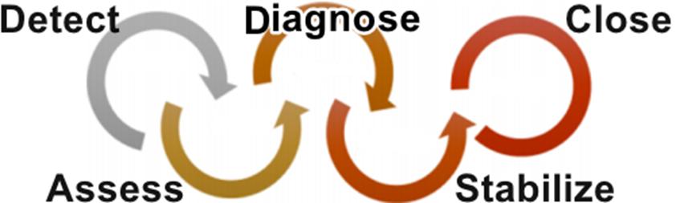
Walkthrough: Azure Security Center usage scenarios
You can use Security Center in the Detect, Assess, and Diagnose stages of an incident response.
Notes:
Azure Security Center planning and operations guide - https://docs.microsoft.com/en-us/azure/security-center/security-center-planning-and-operations-guide

Slide 26

Explore Azure Key Vault
Stores application secrets in a centralized cloud location, to securely control access permissions, and access logging.
Secrets management.
Key management.
Certificate management.
Storing secrets backed by hardware security modules (HSMs).
Notes:
Azure Key Vault -https://azure.microsoft.com/en-us/services/key-vault/

Slide 27
Walkthrough – Implement Azure Key Vault
Create an Azure Key vault and then create a password secret within the key vault.
Create an Azure key vault.
Add a secret to the Azure key vault.

Slide 28

Define Azure Information Protection (AIP)
Classifies and protects documents, and emails, by applying labels.
Automatically using rules and conditions defined by administrators.
Manually, by users.
By combining automatic and manual methods, guided by recommendations.
Notes:
For purchasing details, see : https://azure.microsoft.com/en-us/pricing/details/information-protection/
AIP - https://docs.microsoft.com/en-us/azure/information-protection/what-is-information-protection
Automatically using rules and conditions defined by administrators.
Manually, by users.
By combining automatic and manual methods, guided by recommendations.

Slide 29

Define Azure Advanced Threat Protection (Azure ATP)
Cloud-based security solution for identifying, detecting, and investigating advanced threats, compromised identities, and malicious insider actions.
Dedicated portal for monitoring and responding to suspicious activity.
Sensors installed directly onto your domain controllers.
Cloud service runs on Azure infrastructure.
Notes:
ATP - https://azure.microsoft.com/en-us/features/azure-advanced-threat-protection/

Slide 30
Knowledge Check Populate with instructions to use the polling tool of your choice
Which one?
A). Azure Portal
B). PowerShell
C). Local Tool
Module: Security Tools and Features
Use your Smartphones or Mobile Devices
Go to (insert polling app link of your choice) Enter Code: 123-45-678
Please participate in the quiz for this section
Notes:
WWL recommends using polling to be completed for every 7 – 10 slides and preferably at the end of each section. This helps break classes up and adds more interactivity especially for remote classes.
In order to promote interactivity, WWL suggests the use of Mentimeter, Kahoot or a similar polling technology. Please feel free to adjust this slide as needed and populate with the instructions based on the polling tool of your choice.

Slide 31
Summary: Security Tools and Features
This module is only introductory. Security is a deep and complex topic, so whatever your cloud approach, an ongoing security education is necessary. But this module should get you started in the right direction.
We explored:
Azure Security Center.
Azure Key Vault.
Azure Information Protection
Azure Threat Protection.

Slide 32
Module: Azure Governance methodologies

Slide 33
Azure Governance Methodologies Introduction
Learning objectives:
Apply policies to control and audit resource creation.
Learn how role-based security can fine-tune access to your resources.
Review Microsoft's policies and privacy guarantees.
Learn how to monitor your resources.

Slide 34

Define Azure Policy
Azure Policy is a service to create, assign, and, manage policies. These policies enforce different rules and effects over your resources, so those resources stay compliant with your corporate standards and service-level agreements (SLAs).
Notes:
Azure Policy - https://azure.microsoft.com/en-us/services/azure-policy
Stay compliant with your corporate standards and service level agreements (SLAs) by using policy definitions to enforce rules and effects for your Azure resources.
Evaluates and identifies Azure resources that do not comply with your policies.
Provides built-in policy and initiative definitions, under categories such as Storage, Networking, Compute, Security Center, and Monitoring.

Slide 35
Implementing Azure Policy
Create a policy definition
Assign the definition to resources
Review the evaluation results
A policy definition expresses what to evaluate and what action to take.
Implement your policy definition by assigning it to a group of resources.
Review the results. Results are either compliant or non-compliant.
Notes:
✔️ Policy evaluation happens about once an hour, which means that if you make changes to your policy definition and create a policy assignment then it will be re-evaluated over your resources within the hour.
Azure Policy Samples - https://docs.microsoft.com/en-us/azure/governance/policy/samples/

Slide 36
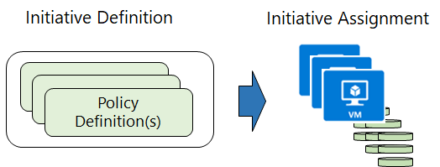
Define Policy Initiatives
Policy Initiatives work with Azure Policies
Initiative definitions group multiple policy definitions into a single unit, to track compliance at a higher scope. For example, one initiative can monitor all your Azure Security Center recommendations.
Initiative assignments are assigned to a specific scope and reduce the need to make an initiative definition for each scope.

Slide 37
Walkthrough - Create an Azure Policy
Create an Azure Policy to restrict deployment of Azure resources to a specific location.
Create a policy assignment.
Test the allowed location policy.
Delete the policy assignment.
Notes:
You can use this as a demonstration, have the students step through the tasks together, or have the students try it themselves.

Slide 38






Explore Role-based access control (RBAC)
Fine-grained access management
Segregate duties within your team and grant only the amount of access to users that they need to perform their jobs.
Enables allowing or disallowing access to the Azure portal, and controlling access to resources.
Azure
Active Directory
Azure
subscription
User
Apps
User groups
Resource group
Resource group
Notes:
Azure RBAC - https://docs.microsoft.com/en-us/azure/role-based-access-control/overview

Slide 39
Walkthrough – Manage access with RBAC
Assign roles and view activity logs.
View and assign roles.
View the activity log and remove a role assignment.

Slide 40
Define Resource locks
Lock Types | Read | Update | Delete
CanNotDelete | Yes | Yes | No
ReadOnly | Yes | No | No
Protect your Azure resources from accidental deletion or modification.
Manage locks at subscription, resource group, or individual resource levels within Azure Portal.
Notes:
Resource Locks - https://docs.microsoft.com/en-us/azure/azure-resource-manager/resource-group-lock-resources

Slide 41
Walkthrough – Manage Resource Locks
Create a resource group, add a lock to the resource group and test deletion, test deleting a resource in the resource group, and remove the resource lock.
Create a resource group.
Add a resource lock to prevent deletion of a resource group.
Test deleting a member of the resource group.
Remove the resource lock.

Slide 42

Explore Azure Blueprints
Create reusable environment definitions that can recreate your Azure resources, like VMs, and apply your policies instantly.
Notes:
Azure Blueprints - https://azure.microsoft.com/en-us/services/blueprints/
Help audit and trace your deployments, and maintain compliance using built-in tools and artifacts.
Associate blueprints with specific Azure DevOps build artifacts, and release pipelines, for rigorous tracking.

Slide 43
Define Subscription Governance
There are mainly three aspects to consider in relation to creating and managing subscriptions.
Billing | Reports and chargeback can be generated per subscriptions
Access Control | A subscription is a deployment boundary for Azure resources and can set up role-based access control.
Subscription Limits | Subscriptions are also bound to some hard limitations. If there is a need to go over those limits, then additional subscriptions may be needed. If you hit a hard limit, there is no flexibility.
Notes:
✔️ There is more information about subscription limits - https://docs.microsoft.com/en-us/azure/azure-subscription-service-limits

Slide 44
Knowledge Check Populate with instructions to use the polling tool of your choice
Which one?
A). Azure Portal
B). PowerShell
C). Local Tool
Module: Azure Governance Methodologies
Use your Smartphones or Mobile Devices
Go to (insert polling app link of your choice)
Enter Code: 123-45-678
Please participate in the quiz for this section
Notes:
WWL recommends using polling to be completed for every 7 – 10 slides and preferably at the end of each section. This helps break classes up and adds more interactivity especially for remote classes.
In order to promote interactivity, WWL suggests the use of Mentimeter, Kahoot or a similar polling technology. Please feel free to adjust this slide as needed and populate with the instructions based on the polling tool of your choice.

Slide 45
Summary: Azure Governance Methodologies
Within this module we learned how policy, blueprints, resource locks and other tools like RBAC can help you govern you content.
During this module we explored:
Apply policies to control and audit resource creation.
Learn how role-based security can fine-tune access to your resources.
Review Microsoft's policies.
Learn how to monitor your resources.

Slide 46
Module: Monitoring and reporting in Azure

Slide 47
Monitoring and Reporting Introduction
Learning Objectives:
Review resource tags and the value of using them.
Monitor the health of your Azure solutions and systems.
Check on the help of Azure and its components.

Slide 48
Explore Tags
Provides metadata for your Azure resources.
Logically organizes resources into a taxonomy.
Consists of a name-value pair.
Very useful for rolling up billing information.
OR
owner: joe
department: marketing
environment: production
cost-center: marketing
Notes:
Tags - https://docs.microsoft.com/en-us/azure/azure-resource-manager/resource-group-using-tags

Slide 49
Walkthrough – Implement resource tagging
Create a policy assignment that requires tagging, create a storage account and test the tagging, view resources with a specified tag, and remove the tagging policy.
Create a policy assignment to require tagging.
Create a storage account to test required tagging.
View all resources with a specific tag.
Delete the policy assignment.

Slide 50

Explore Azure Monitor
Collect, analyse, and act on telemetry from cloud and on-premises environments, to maximize your applications’ availability and performance.
Notes:
Azure Monitor - https://azure.microsoft.com/en-us/services/monitor/
Starts collecting data as soon as you create an Azure subscription and add resources.
Activity Logs record all resource creation and modification events.
Metrics measure resource performance and consumption.
Add an Azure monitor agent to collect operational data for a resource.

Slide 51

Explore Azure Service Health
Evaluate the impact of Azure service issues with personalized guidance and support, notifications, and issue resolution updates.
Azure Status | Service Health | Azure Resource Health
Notes:
Azure Service Health - https://azure.microsoft.com/en-us/services/monitor/
Components of Azure service health :
Azure Status provides a global overview Azure services’ state of health.
Service Health has a customizable dashboard for tracking the state of services in the regions you use.
Azure Resource Health can diagnose and obtain support for Azure service issues affecting your resources.

Slide 52
Monitor applications and services
Integrate Azure Monitor with other Azure services to improve your data monitoring capabilities and gain better insights into your operations.
Analyze
Respond
Visualize
Integrate
Use variants of Azure Monitor for resources (containers, virtual machines, etc.), with Azure Application Insights for applications.
Azure Alerts can respond proactively to critical conditions identified in your monitor data and use Auto-scale with Azure Monitor Metrics.
Use Azure Monitor data to create interactive visualizations, charts, and tables with Power BI.
Integrate Azure Monitor with other systems to build customized solutions to suit your needs and requirements.

Slide 53
Knowledge Check Populate with instructions to use the polling tool of your choice
Which one?
A). Azure Portal
B). PowerShell
C). Local Tool
Module: Monitoring and Reporting
Use your Smartphones or Mobile Devices
Go to (insert polling app link of your choice) Enter Code: 123-45-678
Please participate in the quiz for this section
Notes:
WWL recommends using polling to be completed for every 7 – 10 slides and preferably at the end of each section. This helps break classes up and adds more interactivity especially for remote classes.
In order to promote interactivity, WWL suggests the use of Mentimeter, Kahoot or a similar polling technology. Please feel free to adjust this slide as needed and populate with the instructions based on the polling tool of your choice.

Slide 54
Summary: Monitoring and Reporting
During this module we learned about several great tools to help us monitor the health of our solutions in Azure.
We looked at:
The use and value of resource tagging.
How to use Azure Monitor.
Why Azure Service Health can keep us up to date on how Azure and our solutions are running.

Slide 55
Module: Privacy, compliance, and data protection standards

Slide 56
Privacy, Compliance, and Data Protection Introduction
Learning objectives:
List compliance terms and requirements
Review the Microsoft Privacy Statement
Explore the Trust Center, Compliance Manager, and Service Trust Portal
Explain government specific Azure capabilities

Slide 57
Explore Compliance Terms and Requirements
Microsoft provides the most comprehensive set of compliance offerings (including certifications and attestations) of any cloud service provider. Some compliance offerings include.
CJIS (Criminal Justice Information Services ) | HIPAA (Health Insurance Portability and Accountability Act)
CSA STAR Certification | ISO/IEC 27018
General Data Protection Regulation (GDPR) | National Institute of Standards and Technology (NIST)
Notes:
Should discuss the questions below with students. When selecting a cloud provider to host your solutions, you should understand how that provider can help you comply with regulations and standards. Some questions to ask about a potential provider include:
How compliant is the cloud provider when it comes to handling sensitive data?
How compliant are the services offered by the cloud provider?
How can I deploy my own cloud-based solutions to scenarios that have accreditation or compliance requirements?
You can view all the Microsoft compliance offerings at Microsoft Compliance Center - Compliance Offerings

Slide 58

Identify Microsoft privacy statement
Provides openness and honesty about how Microsoft handles the user data collected from its products and services.
The Microsoft privacy statement explains:
What data Microsoft processes.
How Microsoft processes it.
What purposes the data is used for.
Notes:
Microsoft's Privacy Statement at - microsoft.com/privacystatement

Slide 59
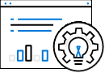
Explore Trust Center
Learn about security, privacy, compliance, policies, features, and practices across Microsoft’s cloud products.
The Trust Center website provides :
In-depth, expert information.
Curated lists of recommended resources, arranged by topic.
Role-specific information for business managers, administrators, engineers, risk assessors, privacy officers, and legal teams.
Notes:
Trust Center - https://www.microsoft.com/trustcenter

Slide 60

Explore Service Trust Portal (STP)
A Trust Center companion website for compliance-related publications about Microsoft cloud services. Hosts the Compliance Manager service.
Use STP to access :
Audit reports across Microsoft cloud services.
Guides to using Microsoft cloud services for regulatory compliance.
Publications about trust, and how Microsoft cloud services protect your data.
Notes:
STP - https://servicetrust.microsoft.com/

Slide 61
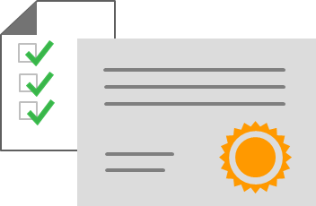
Explore Compliance Manager
Workflow-based, risk assessment tool in Trust Portal that supports your organization's regulatory compliance activities.
Compliance Manager features :
Assign, track, and verify your compliance and assessment-related activities.
Provides a score by evaluating your compliance status.
Stores and manages your compliance-related artifacts in a secure digital repository.
Notes:
✔️ Compliance Manager is a dashboard that provides a summary of your data protection and compliance status, as well as recommendations to improve your data protection and compliance status. The Customer Actions provided in Compliance Manager are recommendations only. Each organization must evaluate the effectiveness of these recommendations, in their respective regulatory environment, prior to implementation. Compliance Manager recommendations should not be interpreted as a guarantee of compliance.

Slide 62
Walkthrough – Explore the Trust Center
Access the Trust Center, Service Trust Portal (STP), and Compliance Manager.
Access the Trust Center.
Access the Service Trust Portal.
Access the Compliance Manager.

Slide 63
Identify Azure Government services
Meets the security and compliance needs of US federal agencies, state and local governments, and their solution providers.
Azure Government :
Separate instance of Azure.
Physically isolated from non-US government deployments.
Accessible only to screened, authorized personnel.
Examples of compliant standards : FedRAMP, NIST 800.171 (DIB), ITAR, IRS 1075, DoD L2, L4 & L5, and CJIS.
Notes:
Azure Government - https://azure.microsoft.com/en-us/global-infrastructure/government/
Acronym explanations
FedRAMP : US Federal Risk and Authorization Management Program (FedRAMP) is a standardized approach for assessing, monitoring, and authorizing cloud computing products and services under the US Federal Information Security Management Act (FISMA).
NIST 800.171 (DIB) : National Institute of Standards and Technology (NIST) 800.171 standardizes security requirements for handling US Federal controlled unclassified information.
ITAR : International Traffic in Arms Regulations (ITAR) relate to managing the export and import of defense articles.
IRS 1075 : US Internal Revenue Service Publication 1075 contains guidelines for US government agencies to protect Federal tax information.
DoD L2, L4 & L5 : US Department of Defense (DoD) Levels 2, 4, and 5 are security authorization requirements for cloud service providers that host DoD information, systems, and applications.
CJIS : US Criminal Justice Information Services’ (CJIS) policies establish security requirements and controls to safeguard criminal justice information.

Slide 64
Identify Azure China 21Vianet
China’s first foreign public cloud service provider, in compliance with government regulations.
Azure China 21Vianet features:
Physically separated instance of Azure cloud services, located in China.
Pperated by 21Vianet (Azure China 21Vianet).
Notes:
Azure China 21Vianet - https://docs.microsoft.com/en-us/azure/china/

Slide 65
Knowledge Check Populate with instructions to use the polling tool of your choice
Which one?
A). Azure Portal
B). PowerShell
C). Local Tool
Module: Privacy, Compliance, and Data Protection
Use your Smartphones or Mobile Devices
Go to (insert polling app link of your choice)
Enter Code: 123-45-678
Please participate in the quiz for this section
Notes:
WWL recommends using polling to be completed for every 7 – 10 slides and preferably at the end of each section. This helps break classes up and adds more interactivity especially for remote classes.
In order to promote interactivity, WWL suggests the use of Mentimeter, Kahoot or a similar polling technology. Please feel free to adjust this slide as needed and populate with the instructions based on the polling tool of your choice.

Slide 66
Summary: Privacy, Compliance, and Data Protection
In this module we learned how Microsoft and Azure are designed and provide tools to help you be more compliant, trust in your solutions, and work with Azure in a government scenario if you need that capability.
We learned about:
Compliance terms and requirements
The Microsoft Privacy Statement
The Trust Center, Compliance Manager, and Service Trust Portal
Government Azure capabilities

Slide 67
Learning Path review
Notes:
As you have time, cover the module review questions in the student materials.

